Slide 1

Design & Analysis of Algorithm
CS-503
Computer Science
Lecture 15
Maximum Flow Algorithm
BY: Bushra Saif

Slide 2
Flow network
In graph theory, a flow network is defined as a directed graph involving a source() and a sink() and several other nodes connected with edges. Each edge has an individual capacity which is the maximum limit of flow that edge could allow.
We can visualize the understanding of the algorithm using a flow of liquid inside a network of pipes of different capacities. Each pipe has a certain capacity of liquid it can transfer at an instance. For this algorithm, we are going to find how much liquid can be flowed from the source to the sink at an instance using the network.
L1.<number>

Slide 3
Constraints
Flow in the network should follow the following conditions:
For any edge(E_{i}) in the network,
0 ≤ flow (E_{i}) ≤ Capacity (E_{i})
Flow on an edge doesn’t exceed the given capacity of the edge.
Total flow out of the source node is equal total to flow in to the sink node.
Incoming flow is equal to outgoing flow for every vertex except s and t.
Netflow in the edges follows skew symmetry i.e. F(u,v)= -F(u,v) where F(u,v) is flow from node u to node v. This leads to a conclusion where you have to sum up all the flows between two nodes(either directions) to find net flow between the nodes initially.
L1.<number>

Slide 4
Max flow
What is the greatest rate at which material can be sent (shipped) from source to the sink without violating any capacity constraints?
Given a flow network G with source s and sink t, the maximum flow problem is an optimization problem to find a flow of maximum value from s to t. Flow network G=(V, E), is essentially just a directed graph where each edge has a nonnegative flow capacity.
Multiple algorithms exist in solving the maximum flow problem. Two major algorithms to solve these kind of problems are Ford-Fulkerson algorithm and Dinic's Algorithm. They are explained next.
L1.<number>

Slide 5
Ford-Fulkerson method
The Ford Fulkerson method, also known as ‘augmenting path algorithm’. Ford-Fulkerson algorithm is a greedy approach for calculating the maximum possible flow in a network or a graph.
It was developed by L. R. Ford, Jr. and D. R. Fulkerson in 1956. A pseudocode for this algorithm is given below,
The Ford Fulkerson method depends on four main concepts and they are,
L1.<number>

Slide 6
Basic terminologies
Residual graph:
It is a graph, that has the same vertices as the original network with one or two edges for each edge in the original network. And it indicates the additional possible flow through the network. For each edge, we’ll calculate the residual capacity.
So, to create a residual network we will take our original network and will update the capacity of each edge with the additional flow / RS corresponding to that edge. Then we will also add reverse edges to indicate the amount of flow currently going across the edges of the original network.
L1.<number>

Slide 7
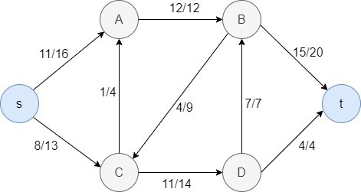
To make this more clear, let’s look at the following example.
Fig:1 Flow network
In the above example, for each edge, the first value represents the flow value and the second stands for the capacity of the edge.
E.g. Let’s consider the edge C-D. Here the flow is 11 and the capacity of the edge is 14. So, if we calculate the additional flow / RS for this edge, we get 14-11 = 3. So in the residual network, we can update the capacity of the C-D edge as 3, and then add a reverse edge with value 11 (flow value of the original network) between C and D.
L1.<number>

Slide 8
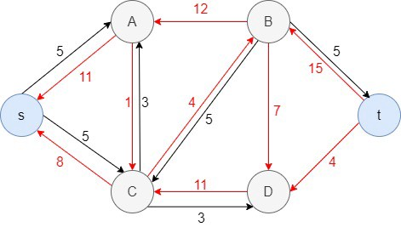
Likewise, we can repeat this for all the edges, and here’s what we get as the residual network.
Fig:2 Residual Network (Reverse edges are marked in red)
L1.<number>

Slide 9
Basic terminologies
Residual Capacity:
Every edge of a residual graph has a value called residual capacity which is equal to original capacity of the edge minus current flow. Residual capacity is basically the current capacity of the edge.
Minimum cut:
It is also known as bottle neck capacity. Which decide maximum possible flow from source to sink through an augmented path. Or minimum capacity of one the edge on path.
Augmenting Path:
It is the path available in a flow network. An augmenting path is a simple path from source to sink which do not include any cycles and that pass only through positive weighted edges.
L1.<number>

Slide 10
Ford-Fulkerson Algorithm
Inputs required are network graph , source node and sink node.
function: FordFulkerson (Graph G, Node S, Node T):
Initialize flow in all edges to 0
while (there exists an augmenting path(P) between S and T in residual network graph):
Augment flow between S to T along the path P
Update residual network graph
return
L1.<number>

Slide 11
Example
Let’s take an network and find maximum flow using ford Fulkerson algorithm.
2
5
5
10
7
3
3
1
1
4
2
7
2
2
10
4
3
7
6
L1.<number>

Slide 12
Solution with Ford Fulkerson
The flow of all the edges is 0 at the beginning
2. Select any arbitrary path from S to T. In this step, we have selected path 1-2-5-7.
3. The minimum cut of this augmented path among the three edges is 5 from node 2 to node 5.
2
0/5
5
0/7
0/10
0/3
0/3
1
0/1
4
0/2
7
0/2
0/2
0/10
0/4
3
0/7
6
L1.<number>

Slide 13
Solution with Ford Fulkerson
4. Consider this minimum cut as 1st flow value and add flow value to all edges on this path.
5. Calculate the residual capacity of every edge on this augmented path by using this formula,
Residual capacity = Current capacity – Flow
6. Block the flow between that edges which has 0 residual capacity. In this case flow from node 2 to 5 will block.
2
5/5
5
5/7
5/10
0/3
0/3
1
0/1
4
0/2
7
0/2
0/2
0/10
0/4
3
0/7
6
L1.<number>

Slide 14
Solution with Ford Fulkerson
Residual graph after 1st path is given below,
5
2
5
2
5
3
3
5
5
1
1
4
2
7
2
2
10
4
7
3
6
L1.<number>

Slide 15
Solution with Ford Fulkerson
Now select the 2nd augmented path from node 1 to 7. Let’s consider 1-3-6-7.
Apply the same procedure to calculate flow of this path that is 4 in this case. Update the flow value on all edges of this path. Calculate the residual capacity of all sub paths including in this augmented path. According to results node 6 to node 7 flow will not allowed.
2
5/5
5
5/7
5/10
0/3
0/3
1
0/1
4
0/2
7
0/2
0/2
4/10
4/4
3
4/7
6
L1.<number>

Slide 16
Solution with Ford Fulkerson
Residual graph after 2nd path is given below,
2
5
5
2
5
3
3
5
5
1
1
4
2
7
2
2
6
4
4
3
3
6
4
L1.<number>

Slide 17
Solution with Ford Fulkerson
Now select the 3rd augmented path from node 1 to 7. Let’s consider 1-2-4-5-7.
Apply the same procedure to calculate flow of this path that is 2 in this case. Update the flow value on all edges of this path. Calculate the residual capacity of all sub paths including in this augmented path. According to results node 1 to node 2 flow will not allowed.
2
5/5
5
7/7
7/10
2/3
2/3
1
0/1
4
0/2
7
0/2
0/2
4/10
4/4
3
4/7
6
L1.<number>

Slide 18
Solution with Ford Fulkerson
Residual graph after 2nd path is given below,
2
5
5
7
1
7
1
2
2
3
1
1
4
7
2
6
2
2
4
4
3
3
6
4
L1.<number>

Slide 19
Solution with Ford Fulkerson
We will keep iterating these steps until we have any path to go from source to sink.
Now select the 4th augmented path from node 1 to 7. Let’s consider 1-3-4-5-7. Apply the same procedure to calculate flow of this path that is 1 in this case. Update the flow value on all edges of this path. Calculate the residual capacity of all sub paths including in this augmented path. According to results node 4 to node 5 flow will not allowed.
2
5/5
5
7/7
8/10
2/3
3/3
1
0/1
4
0/2
7
1/2
0/2
1/10
4/4
3
4/7
6
L1.<number>

Slide 20
Solution with Ford Fulkerson
2
5
5
7
1
8
3
2
2
1
1
4
7
2
9
2
1
4
1
1
3
3
6
4
Look! Now there are no paths left from the s to t in the residual graph. So, there is no possibility to add flow. This means the Ford Fulkerson method is complete and we are ready to find the maximum flow.
L1.<number>

Slide 21
Augmenting path | Minimum cut
1-2-5-7 | 5
1-3-6-7 | 4
1-2-4-5-7 | 2
1-3-4-5-7 | 1
Maximum flow through the given network using ford Fulkerson algorithm is,
Total flow = 5+4+2+1 = 12
L1.<number>

Slide 22
Applications
Water distribution pipeline
Bipartite matching problem
Circulation with demands
L1.<number>

Slide 23
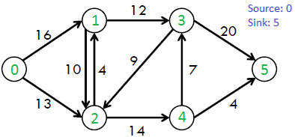
Example 2
Try to solve this example by using below flow network and find out maximum flow.
L1.<number>

